Slide 1


Smart Self-Defense Band For Women’s Safety
Final Project Presentation on
BY:
Aishwarya M (1RR20EC002)
K JAI AKHIL (1RR20EC026)
LIKITHA s (1RR20EC029)
RAKSHITH S (1RR20EC043)
PROJECT GUIDE: DR.DEEPIKA J
Associate Professor
Dept. of ECE, RRCE
Dept. of ECE,RRCE
1

Slide 2
CONTENTS
1.Abstract
2.Introduction
3.Literature survey
4.Methodology
5.Hardware/Software required
6. Hardware Components
7. Result
8. Conclusion
9. Future Scope
10. References
Dept.of ECE,RRCE
2

Slide 3
1. ABSTRACT
Women worldwide are experiencing and being subjected to unethical physical harassment.
For women and girls worldwide, sexual harassment and other forms of sexual abuse in public areas, urban or rural, are daily occurrences.
Our project offers a wearable safety band for women, delivering an minute electric shock to assailants, empowering self-defense without external help.
This band includes an SOS system usable with or without internet connectivity, allowing real-time location sharing via GPS.
This safety band, equipped with a camera module, offers live streaming capability
Dept.of ECE,RRCE
3

Slide 4
2. INTRODUCTION
According to a recent survey conducted in India, more than half (53%) of employed women express concerns about feeling unsafe in their workplaces or surroundings.
Recent years have seen a rise in concerns about women's safety, demanding innovative solutions.
Our project offers a wearable safety band for women. It administers an electric shock to assailants, allowing the wearer to protect herself independently.
This multifunctional wearable device integrates advanced tech to offer women comprehensive safety solutions.
This device, with its array of features including a shock generator, camera module, GPS, GSM connectivity, buzzer alert system, temperature sensor, and heartbeat sensor, revolutionizes personal safety.
Dept.of ECE,RRCE
4

Slide 5
2. INTRODUCTION
It utilizes GPS technology for precise location tracking.
It incorporates GSM connectivity for immediate communication and alerts to authorities or designated contacts.
Monitors ambient temperature for potential safety risks.
Tracks heartbeat for health monitoring and emergency response.
It empowers women with confidence to navigate the world securely.
Dept.of ECE,RRCE
5

Slide 6
3.LITERATURE SURVEY
Paper No. | Paper Title | Authors | Methodology Used | Limitation
1. | Wearable Women Safety Device | C. Gautam, A. Patil, A. Podutwar, M. Agarwal, P. Patil and A. Naik | Integrates GPS, GSM, sensors for comprehensive safety. | Safety device rely on Bluetooth technology.
2. | Smart Gadget for Women’s Safety | Akanksha Chandoskar, Shraddha Chavan, Yojana Mokal, Payal Jha, Pournima | The proposed gadget for women safety comprises, 8051 Microcontroller, Panic Button, Sensors. | This device usually lack physical self-defense mechanisms.
3. | Women safety system using ESP 32 and integrated safety app | R Anitha | ESP 32 microcontroller based on ATmega328P has the function of send and receive data. | The response time of emergency services or individuals can vary.
4. | Design of Women’s Safety Device | Divya Chitkara | Uses sensors such as gyroscope to protect them from their oppressor. | Accelerometers and gyroscopes may struggle to differentiate normal movements from distress signals, leading to false results.s
5. | Safety Solution for Women using Smart Band and CWS app | A.Z.M Tahmidul Kabir, Al Mamun Mizan,Tasnuva Tasneem | If any incident occurs, this device can track the user’s location in real-time and send it to the nearby police station and contacts. | This device require a companion mobile app for configuration and monitoring.
Dept.of ECE,RRCE
6

Slide 7
Paper No. | Paper Title | Authors | Methodology Used | Limitation
6. | Wearable Women Safety Device using Raspberry Pie | Prottasha Ghosh, Tanjim Masroor Bhuiyan | This uses a raspberry pie as microcontroller. | Camera module is not included .
7. | A Smart Alarm System for Women’s Security | K.Mohanaprakash and T.Guna Sekar | It includes a buzzer for the alaram . | The effectiveness of a smart alarm system may be limited to the specific location where it is installed.
8. | ESP 32 Based Security System for Women | Abhijeet Mane, Manoj Gharge, Omkar Pol, Karan Grover, Prof. Vijaya Chavan. | The proposed system consists of Push button, ESP32 microcontroller and Wi-Fi module. | In areas with poor or no network connectivity, this device that rely on cellular networks for communication may be ineffective.
9. | One Touch Alarm for Women’s Safety Using Arduino | C. Priya, Ramya C, Befy D, Harini G, Shilpa S, SivaniKiruthiga B | The hardware device used for this is ARM controller. It is the most productive system and it uses up very less power. | Location provided by the system was not accurate or precise enough.
10. | SMART SOLUTION FOR WOMEN SAFETY USING IoT | A.Jesudoss, Y. Nikhila, T. Sahithi Reddy | It includes a various sensors along with microcontroller. | This method has many drawbacks as she need to unlock the mobile phone which may take more time during panic situations.
Dept.of ECE,RRCE
7

Slide 8
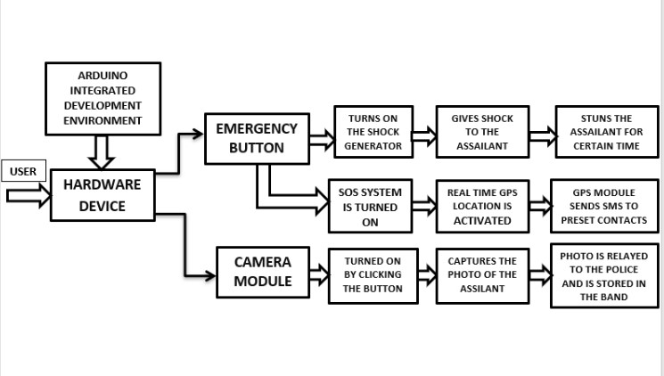
4. METHODLOGY:
HARDWARE DEVICE
GS
GSM MODULE IS USED TO SEND A TEXT MESSAGE WHICH INCLUDE THE LOCATION
li
LIVESTREAMING
li
li
HEART RATE MONITOR
TEMPERATURE SENSOR
Figure 2.Block Diagram of the Proposed Methodology
Dept.of ECE,RRCE
8

Slide 9
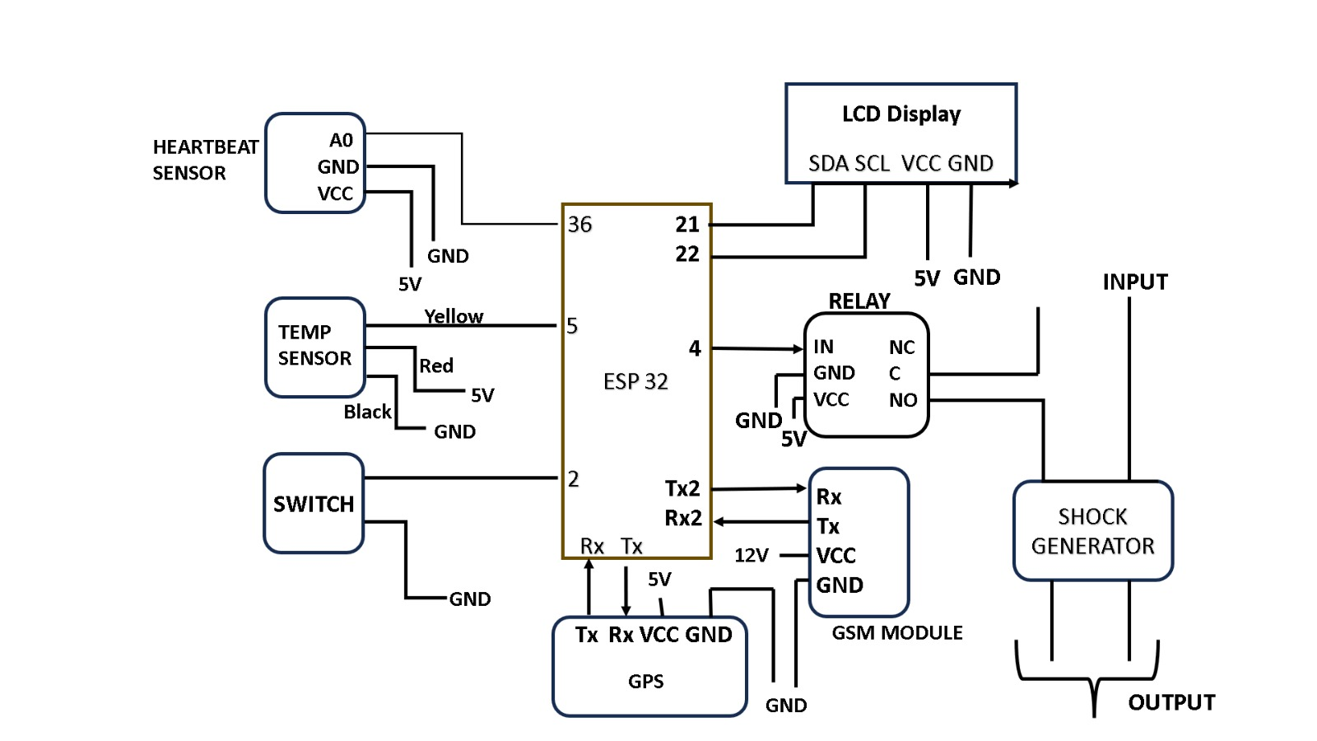
4.BLOCK DIAGRAM
DS18B20
400K STEP UP POWER MODULE
SimCom SIM900A GSM Module
Dept.of ECE,RRCE
9

Slide 10
4. METHODOLOGY:
Activation: When the user senses a threat or feels unsafe, they can activate the band by pressing a button or triggering a specific gesture, depending on the design.
Shock Mechanism: If the user is physically attacked, the band can deliver a non-lethal shock to the assailant upon activation. This shock is intended to deter the attacker and give the user a chance to escape.
GPS Tracking: Simultaneously, the band activates its GPS system to pinpoint the user's real-time location.
Alert Notification: The band sends an alert message with the user's location to predefined emergency contacts or a dedicated monitoring center via the GSM network.
Emergency Response: The emergency contacts or monitoring center receive the alert and can take appropriate action, such as notifying local authorities or dispatching help to the user's location
GS
Dept.of ECE,RRCE
10

Slide 11
5.2 FLOWCHART:
During Attack Scenario
NO
The Safety band is turned off
Button Pressed
YES
The Safety band is turned on
The Camera and Message Module is initialized
The Camera and Message Module is initialized
Emergency SMS sent to contacts with Location via GSM
The Shock Generator is turned on
Shocking the assailant
The Shock Generator is turned off
Dept.of ECE,RRCE
11

Slide 12
5. HARDWARE/SOFTWARE REQUIRED
Software:
Embedded C
Arduino IDE
Hardware:
ESP32
2.4 inch TFT display
Node MCU
Bluetooth
Shock generator
Switch
ESP32 Camera Module
Power supply
Heartrate Sensor
Temperature Probe
Dept.of ECE,RRCE
12

Slide 13
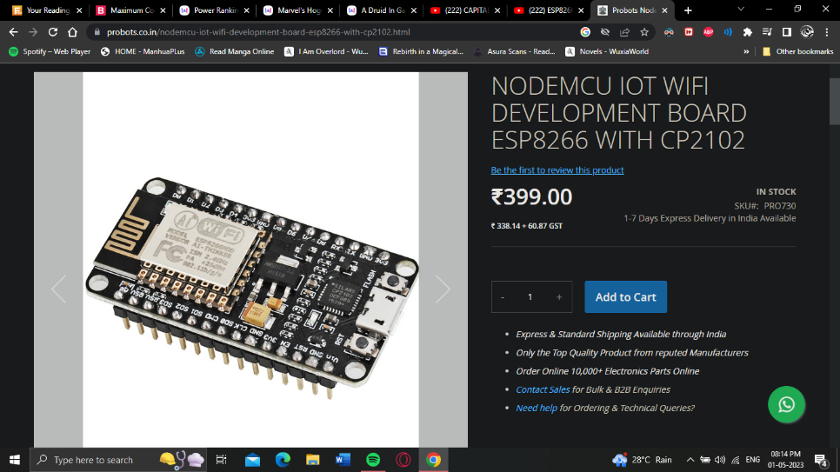
6. HARDWARE COMPONENTS
8.1 ESP-32
Microcontroller: Tensilica 32-bit Single-/Dual-core CPU Xtensa LX6
Operating Voltage: 3.3V
448 KB of ROM for booting and core functions.
520 KB of on-chip SRAM for data and instructions.
4MB of Flash Memory
16 KB SRAM in RTC
32 Multifunctional GPIO pins
Analog Outputs Pins (DAC): 3 SPIs: 2 I2Cs:
Clock Speed: 240 Mhz
Fig. ESP-32
Dept.of ECE,RRCE
13

Slide 14
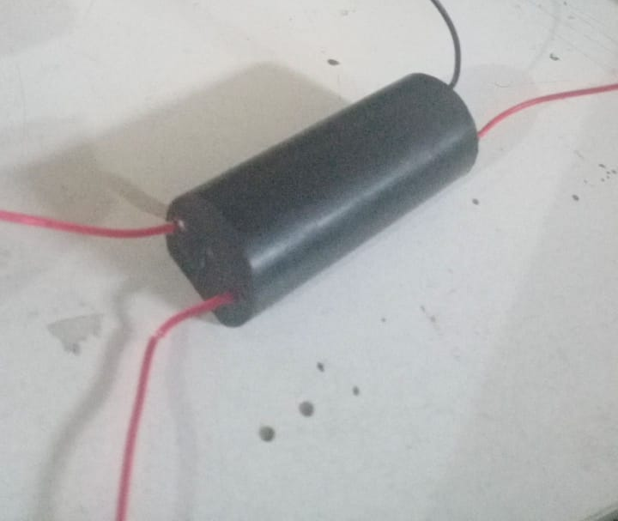
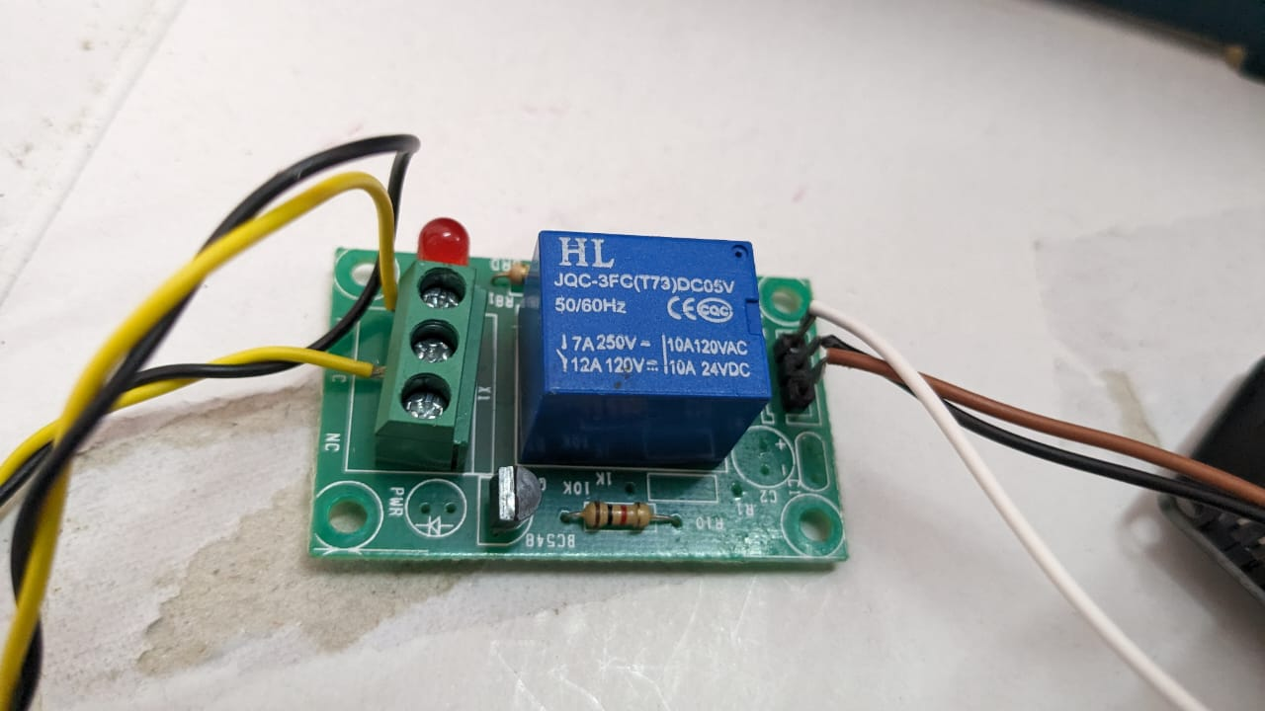
6. HARDWARE COMPONENTS
8.2 400KV STEP UP POWER MODULE (SHOCK GENERATOR )
Input voltage: 3.7 - 6V
Input Current: 4A Output voltage: DC 200-400KV (Please be sure to use safety when used)
Output current: 0.5A
High voltage bipolar discharge distance: 15mm
High type: pulse current
Structure: High and low voltage integrated
Fig. 400V STEP POWER MODULE
8.3 HL-JQC-3FC(T73) RELAY
Trigger Voltage (Voltage across coil) 5V DC
Trigger Current (Nominal current) 70mA
Maximum AC load current 7A / 250 - 10A/ 125VAC
Maximum DC load current 12A / 120 - 10A / 28VDC
Operating time 10msec
Release time 5msec
Fig HL-JQC-3FC(T73) RELAY
Dept.of ECE,RRCE
14

Slide 15
6. HARDWARE COMPONENTS
8.4 Temperature Probe (DS18B20)
Range- | -55°C to 125°C
Accuracy- | +-0.5°C
Levels- | 0 and 5 Volt
Power- | +12 Volt 3,5 mA (+5,5 .... +20 Volt)-5 Volt 1 mA (-4,5 ....-8 Volt)
Dimension- | 224 x 120 x 60 + 40 mm
Waterproof Digital stainless steel probe
Length- 100cm
It provides 9bit to 12-bit Celsius temperature
Fig. Temperature Probe
Dept.of ECE,RRCE
15

Slide 16
6. HARDWARE COMPONENTS
8.6 Heartrate Sensor
Power supply voltage- | 3.3V ~ 5V
PCB Diameter (mm)- | 15
Package Dimensions - | 8 × 6 × 2 cm
Weight - | 50 grams
8.7 ESP Camera Module
Fig. Heartrate Sensor
Input Voltage (Volt)- | 5V
Operating Temperature (°C)- | -20 ~ 85
SPI Flash- | Default 32Mbit
Bluetooth- | Bluetooth 4.2 BR/EDR and BLE standards
RAM- | 520KB SRAM + 4MB PSRAM
Wi-Fi- | 802.11 b/g/n/
Package Dimensions - | 11 x 9 x 5cms
Weight - | 50 grams
Fig. ESP32 Camera Module
Dept.of ECE,RRCE
16

Slide 17
6. HARDWARE COMPONENTS
8.6 GSM module(SimCom SIM900A GSM Module with SMA Antenna)
Model - | SIM900A
Baud Rate - | 1200-115200
Dimensions - | 5 x 4 x 3cms
Weight- | 5 grams
8.7 Neo 6M GPS Module
Input Voltage- | 2.7 - 3.6V
Model- | GY-GPS6MV2 Ceramic antenna
Mounting Hole Diameter- | 3mm
Baud Rate- | 9600 Baud default (Configurable from 4800 to 115200 Baud)
Antenna size- | 18 * 18mm
Module size- | 23mm * 30mm
Cable- | 20mm
Weight- | 50 grams
Fig. GSM Module
Fig. GPS Module
Dept.of ECE,RRCE
17

Slide 18
7. RESULTS
Our primary goal is to ensure every woman in our society to feel safe and secure.
The ESP-32 has been integrated with the Shock generator to deliver minute shocks to the assailant.
The band is designed for all-day wear, with materials that are comfortable and skin-friendly.
We have also included the heart-rate sensor and temperature probe to measure the heart-rate and temperature of the user and send the
It has a GPS or GSM tracking technology to share the wearer's location in real-time.
The band has a discreet camera module for livestreaming during emergencies
Dept.of ECE,RRCE
18

Slide 19
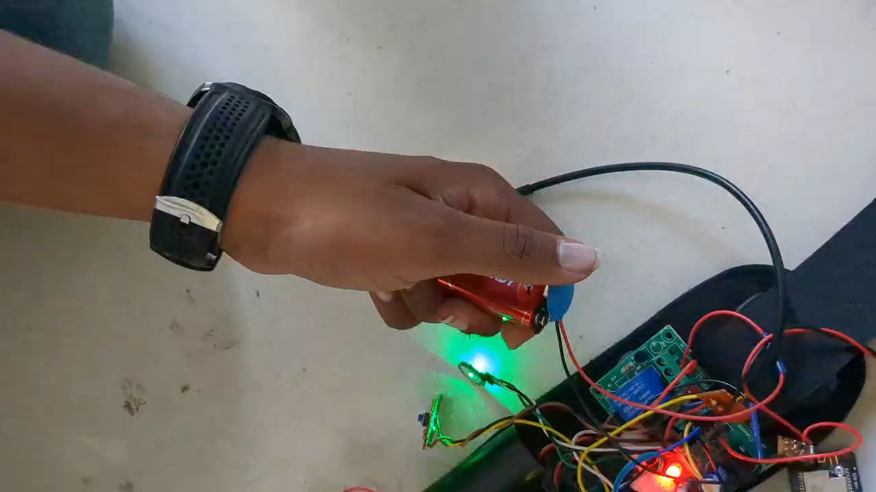
7.RESULTS
Dept.of ECE,RRCE
19

Slide 20
7. RESULT
Serial Number | Parameters | Preexisting Device | Proposed Device
1 | Deterrence | Shocker Generator is not implemented | Shocker provides effective deterrence
2 | Data Collection | Can sometimes capture images but not accurate | Can livestream
3 | Communication | Not Streamlined enough and can’t use phone during emergencies | Has a GSM and GPS module which sends real time location
4 | Portability | Has to be carried in a bag | Highly portable and can be worn on the hand
Dept.of ECE,RRCE
20

Slide 21
8. CONCLUSION
The integration of a shock generator, camera module, GPS, GSM, and buzzer into the women safety band significantly enhances the safety features available to the wearer.
The GPS and GSM modules enable real-time tracking and monitoring of the wearer's location, providing immediate assistance in case of emergency.
The presence of a shock generator acts as a deterrent to potential attackers, providing an added layer of protection to the wearer.
The camera module allows for the discreet capturing of images or video footage, which can serve as valuable evidence in case of harassment or assault.
The band is designed to be user-friendly, allowing easy activation of distress signals and functions, ensuring quick response during emergencies.
Dept.of ECE,RRCE
21

Slide 22
9. FUTURE SCOPE
Self Defense Simplified
Portability and Reusability
Enhanced Security and Protection
Real time data transmission
Betterment of Society
Dept.of ECE,RRCE
22

Slide 23
8.REFERENCES
[1.] Chitkara, D., Sachdeva, N., & Vashisht, Y. D, “Design of a women safety device” .
[2.] Hussain, S. M., Nizamuddin, S. A., Asuncion, R., Ramaiah, C., &Singh, A. V. (2016, September). “Prototype of an intelligent system based on RFID and GPS technologies for women safety.”
[3.] “Study: 94% women victims of sexual harassment in public transport”,
[4.] Dhaka Tribune. Smith, M. J., & Clarke, R. V, “Crime and public transport .Crime and Justice.”
[5.] Heise, L., Ellsberg, M., & Gottemoeller, M. “Ending violence against women. Population reports.”
[6.] Mahajan, M., Reddy, K. T. V., & Rajput, M. “ Design and implementation of a rescue system for safety of women.”
[7.] G. Toney, F. Jabeen, and Puneeth S, “Design and implementation of safety armband for women and children using ARM7,”
[8.] N. Viswanath, N. V. Pakyala, and G. Muneeswari, “Smart foot device for women safety,”
[ 9.] C. Gautam, A. Patil, A. Podutwar, M. Agarwal, P. Patil and A. Naik “Wearable Women Safety Device”.
[10.] Akanksha Chandoskar, Shraddha Chavan, Yojana Mokal, Payal Jha, Pournima ,” Smart Gadget for Women’s Safety.
[11.] Basavaraj Chougula, Archana Naik, Monika Monu, Priya Patil and Priyanka Das-“ Smart girls security system International Journal of Application or Innovation in Engineering & Management (IJAIEM) “ISSN:2319-4847 Volume 3, Issue 4, April 2014.
[12.] Borges,L.M. Inst. de Telecomun.-DEM, Univ. da Beira Interior, Covilh Portugal Barroca, N. ; Velez, F.J. ; Lebres, A.S-“Smart-clothing wireless flex sensor belt network for foetal health monitoring; Pervasive Computing Technologies for Healthcare, 2009. Pervasive Health 2009. IEEE, London.
[13.] Rahdar, R. ; Bell Helicopter, Fort Worth, TX, USA ; Stracener, J.T. ; Olinick, E.V-“A Systems Engineering Approach to Improving the Accuracy of Mobile Station Location Estimation Systems Journal”, IEEE (Volume:8 , Issue: 1 ,2013).
[14.] Guang Zhang, “Medical alert systems with Tele Health& telemedicine monitoring using GSM and GPS technology”, IEEE Conference, Coimbatore, 2012
[15.] JiewenZheng; Inst. of Med. Equip., Acad. of Mil. Med. Sci., Tianjin, China ; Guang Zhang ; Taihu Wu, Design of Automatic Accelerometer for Elderly Based on Triaxial Accelerometer ; Bioinformatics and Biomedical Engineering , 2009. ICBBE 2009. 3rd International Conference, IEEE Beijing.
[16.] Mirjami Jutila, Helen Rivas, Pekka Karhula, Susanna Pantsar "Implementation of a Wearable Sensor Vest for the Safety and Well-being of Children", The second international Workshop on Body Area Sensor Networks(BASNet-2014), Elsevier B.V, 2014.
Dept.of ECE,RRCE
23

Slide 24
THANK YOU
Dept.of ECE,RRCE
24

